Slide 1
WOODLAND School District 2019-20120 Year End Financial Summary
Presented by:
Stacy Brown
Exec Director of Business Services

Slide 2
Historical Fund Balance Summary
History of total fund balance at year-end and the percentage of budgeted expenditures
Year Ended | % of Expenditures | Budget | Total Fund Balance
2013 | 11.8% | $ 21,251,166.00 | $ 2,515,483.00
2014 | 11.8% | $ 23,652,108.00 | $ 2,785,917.00
2015 | 11.4% | $ 25,016,430.00 | $ 2,842,390.00
2016 | 9.5% | $ 28,233,915.00 | $ 2,676,560.00
2017 | 9.1% | $ 30,270,375.00 | $ 2,764,560.00
2018 | 7.9% | $ 33,573,646.00 | $ 2,636,629.00
2019 | 7.2% | $ 37,468,437.00 | $ 2,695,935.00
2020 | 9.9% | $ 40,114,208.00 | $ 3,953,697.00

Slide 3
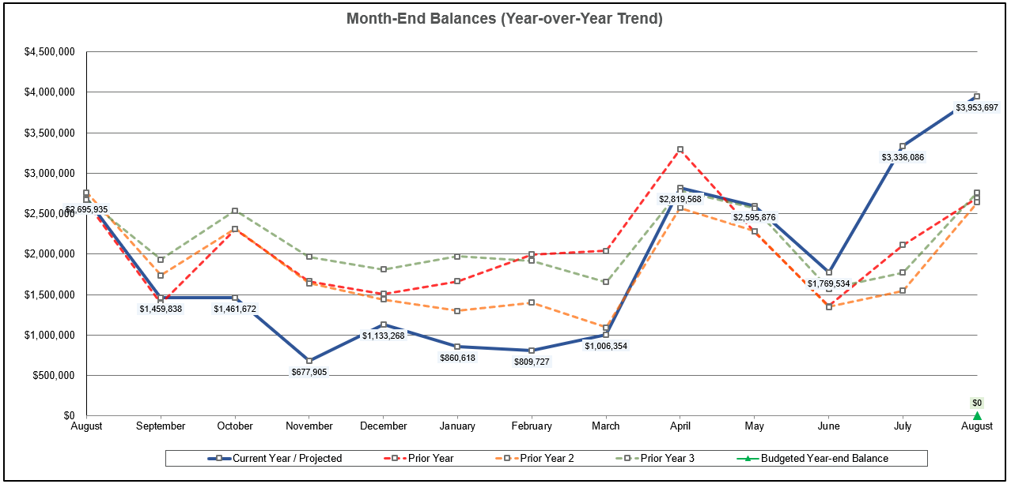
Monthly FB Summary

Slide 4
Fund Balance/Enrollment
 | August 31, 2020 | August 31, 2019
Total Ending Fund Bal – NEW 19-20 (SF0/SF1) | $3,953,697 $2,769,175/$1,184,523 | $2,695,935
Restricted for Pgm Carryover | $ 2,714 | $ 239,071
Nonspendable for Prepaid Exp | $ 218,073 | $ 264,308
Assigned for Building/Dept CO | $ 243,020 | $ 114,937
Unassigned Fund Bal | $3,489,890 | $2,077,619
Unreserved FB Increase 18-19 to 19-20 | $1,412,271 | ($ 209,864)
Budgeted Inc/(Dec) in FB | ($ 213,031) | ($ 65,863)
Actual Inc/(Dec) in FB | $1,257,763 | $ 53,068
Budgeted Enrollment | 2,406.00 | 2,460
Actual Enrollment | 2,387.68 | 2,461.13

Slide 5
GF Financial Summary-YTD % of Budget

Slide 6
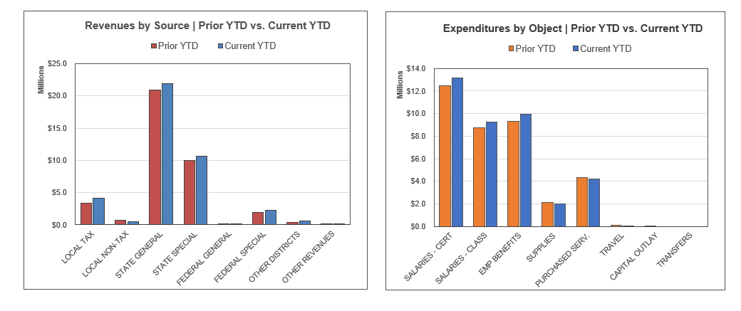
Revenues/Expenditures By Object, Compared to Prior Year (does not include transfers)

Slide 7
Items Directly Affecting Total Fund Balance
Item/Description
Certificated Salaries Less Than Budgeted (Subs made most difference) | $ 112,500
Classified Salaries Less Than Budgeted (Subs, Unfilled Positions) | $ 191,000
Benefits (Insurance, Retirement, Mandatory Benefits) Less Than Budget | $ 317,000
Maint Supplies & Operating Costs (MSOCS) Less Than Budgeted (Buildings, Maintenance, Utilities, Transportation Fuel and Parts) | $673,000
State Special Purpose Greater Than Budgeted (Special Ed, Transportation) | $250,000
Covid 19 (ESSER) Funds | $ 207,000
WCC Expenditures Less than Revenues | ($ 64,000)
Local Revenues Less than Budgeted | ($ 35,000)
KWRL Transfer to Capital Projects Fund | ($400,000)
Budgeted Transfer from CPF to GF not Made | ($100,000)
Total | $1,251,500

Slide 8
GF Financial Summary-PY, YTD and Comparison to Budget

Slide 9
Levy/Local Dollars
Expenditure Type | Levy Dollars 2019-20120 | Levy Dollars 2018-2019
Certificated Salaries | $ 701,000 | $ 46,900
Classified Salaries | $1,293,000 | $1,646,000
Administrator Salaries | $ 170,000 | $ 84,000
Benefits | $ 916,950 | $1,003,000
Supplies/Services/Travel/Utilities/Insurance | $ 71,000 | $ 446,000
Extracurricular | $ 541,000 | $ 600,000
Special Education | $ 287,000 | $ 285,000
Food Service Program | $ 206,000 | $ 192,000
To/From Transportation/Bus Purchase | $ 279,000 | $ 214,000
Daycare | $ 64,000 | $ 40,000
Family Resource Center | $ 6,000 | $ 52,000

Slide 10
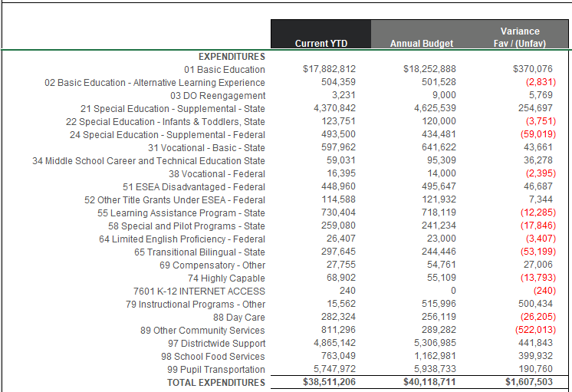
GF Detailed Expenditures (By Program) and Comparison to Budget

Slide 11
Transportation & Food Service
Transportation
Food Service
Total Students transported = Approx 5,500 Basic average per day and 370 Special Ed/Homeless per day average
Total Expenditures (inc Utilities) = $5,754,239
Total Revenues = $5,703,710
Total Unfunded = $50,529 Budgeted unfunded plus utilities was $608,732.
District received funds from other districts based on budgeted unfunded. This resulted in $441,000 total received, greater than the annual costs. It was decided to transfer $400,000 to the Capital Projects Fund for KWRL projects. The remaining $43,000 was carried forward into 20-21.
Woodland’s portion of unfunded plus CPF Transfer is $233,995, which represents 36.11% ownership of the Co-Op (2.48% increase from 18-19)
National School Lunch Program run through March 2020. This program resulted in a loss of $112,000 for the time period.
Due to the pandemic, the Summer Food Service Program was run (delivery) through the end of June and then the traditional summer program (pick up at WMS only) was run in July and August. This program ran at a loss of approx. $10,000.
Unlike other programs, any staff that did not work during the spring closure had to be transferred out of the program. The total of approximately $96,000 had to be covered by levy funds.
Sodexo Guarantee ($225,000) and the actual for this year was ($218,000). Many of the costs transferred into the pandemic summer program were for meal delivery staff. Even with this transfers and the cost of the Covid staff, the guarantee is met and there will be nothing owed by Sodexo for 19-20.

Slide 12
Before and After School Care
The WCC and YCC programs add opportunities for parents and students in a small community without many daycare options for families
Programs served about 130 families throughout the year and also provided summer care. WCC was closed from mid-March through June, due to the pandemic. As with other programs, staff were paid for contracted hours, even though they were not providing services to students.
WCC program is licensed by the state and able to provide options for low income families
Daycare programs ran at a loss of $64,000. Last year they had a loss of almost $40,000. Considering the closure and the increased staffing to ensure social distancing, this loss was to be expected.
The program continues to provide an important service in a community with very little daycare available and providing convenience for parents (now at both schools). WCC continues to provide before, after and full-day care during remote and hybrid learning.

Slide 13
Other Funds
Capital Projects
Debt Service
ASB
Transportation vehicle

Slide 14
Capital Projects Fund
Beginning Fund Balance $ 317,704
Revenues/Other Fin Srce $ 885,601
Expend/Other Fin Uses $ 426,033
Ending Fund Balance $ 777,272
Expenditures were for the WMS water project which was funded by a state grant and the KWRL tank project. Total Fund Balance is made up of $200,500 in Impact Fees and $69,310 Designated for Future Capital Projects, $23,900 in State Grant to complete the water projects and $483,600 for KWRL projects.

Slide 15
Debt Service Fund
This fund is used to collect tax revenue and pay the principal and interest on bonds. Payments are made twice a year, December and June.
 | Debt Balance 9/1/19 | Debt Issued/ Increased | Debt Redeemed/ Decreased | Debt Balance 8/31/20
Voted Debt | $50,165,000 | $ 0 | $ 1,175,000 | $48,990,000
Pension Liability** | $ 7,715,964 | $ 3,860,151 | $ 0 | $11,576,115
Compensated Absences** | $ 554,095 | $ 76,948 |  | $ 631,043
Total | $58,435,059 | $ 3,937,099 | $ 1,175,000 | $61,197,158
** Required to be reported, per accounting rules. Not debt owed.
Amount available for principal/interest at August 31, 2020 = $1,195,195

Slide 16
ASB FUND
ASB funds are for the extracurricular benefit for the students. Their involvement in the decision-making process is an integral part of associated student body government.
Beginning Fund Balance $235,487
Revenues $210,498
Expenditures $188,457
Ending Fund Balance $257,528

Slide 17
TRANSPORTATION VEHICLE FUND
This fund is used to replace buses. Revenue comes from the State (in the form of depreciation payments), interest earned on the investments and the annual levy payments made by the for Co-Op districts.
Beginning Fund Balance $2,999,711
Revenues $ 948,775
Expenditures $ 802,147
Ending Fund Balance $3,146,340

